Slide 2
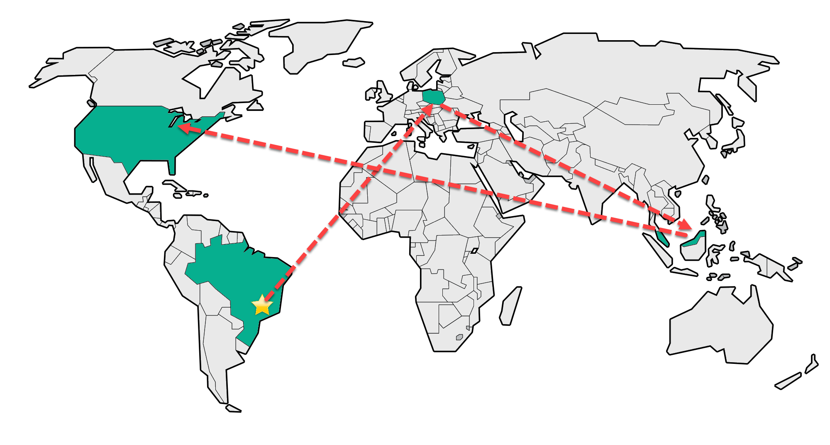

Slide 3






Slide 4


Snagit Windows Core Team

Slide 5
Factory Design Pattern
Creating Objects Without Exposing the Logic

Slide 6
What is a Design Pattern ?
Common Vocabulary
Project Structure Template
Notes:
Common vocabulary of terms to help programmers, designers, engineer to communicate in a higher level, approaches or how to model a project
In other words is a template, just like in College when you English 101 professor asked you to write that Persuasive Essay you had to follow an outline that it was pretty much: Introduction, Body Paragraph with couple arguments ( and develop them), Opposing View Paragraph, and conclusion. So in Software Development, those “Outlines” are the Design Patters.

Slide 7
Benefit of a Design Pattern
Fast communication on how something works
Help break a problem down
Helps with classes/methods getting too big doing too much
Reduces Refactoring
Notes:
Refactoring: Phase where frameworks often emerge, moving operations up or down the class hierarchy, and rationalizing the interfaces of classes

Slide 8
SOLID Principles
Single Responsibility Principle
“a class should have only a single responsibility”
Open/Closed Principle
“should be open for extension, but closed for modification”
Liskov substitution principle
"Objects should be replaceable with instances of their subtypes without altering the correctness of that program"
Notes:
Open/closed principle^{[5]}"software entities … should be open for extension, but closed for modification.“
Liskov substitution principle^{[6]}"objects in a program should be replaceable with instances of their subtypes without altering the correctness of that program.“
design by contract.Interface segregation principle^{[7]}"many client-specific interfaces are better than one general-purpose interface.“
^{[8]}Dependency inversion principle^{[9]}one should "depend upon abstractions, [not] concretions."^{[8]}

Slide 9
SOLID Principles
Interface Segregation Principle​
"Many client-specific interfaces are better than one general-purpose interface"​
Dependency Inversion Principle​
"One should depend upon abstractions, [not] concretions"​

Slide 10

A Brief History
Erich Gamma’s PhD Thesis
Notes:
Erics’s PhD Thesis contained roughly half of the most famous Design Patterns
He helped develop Junit and Eclipse, now he leads a MS development Lab in Zurich ( Visual Studio Online Monaco )

Slide 11
Categories of Patterns
Creational Patterns
Structural Patterns
Behavioral Patterns
Notes:
Eugene present this slide

Slide 12
Creational Patterns
Abstracts the instantiation process
Notes:
. They try to decouple how the objects are created

Slide 13
Creational Patterns
Factory Method
Abstract Factory Method
Builder
Prototype
Singleton

Slide 14
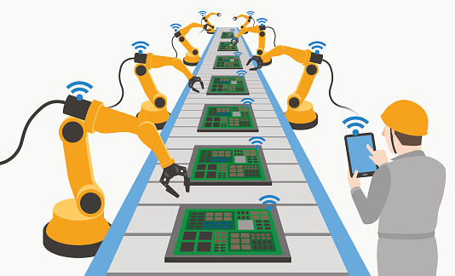
Factory Method Pattern

Slide 15
Definition
“Define an interface for creating an object, but let subclasses decide which class to instantiate. The Factory method lets a class defer instantiation it uses to subclasses."
Notes:
In other words, you want to use a factory pattern whenever you want a method to return one of the several object that share a common super class ( implement the same interface)

Slide 16
Factory Method Example
Notes:
JOKE about forgetting to add the example … Use notepad/ Code editor

Slide 17
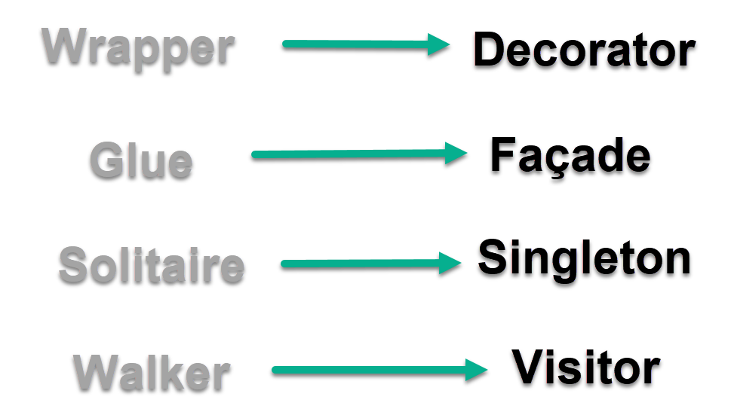
Curiosity

Slide 18
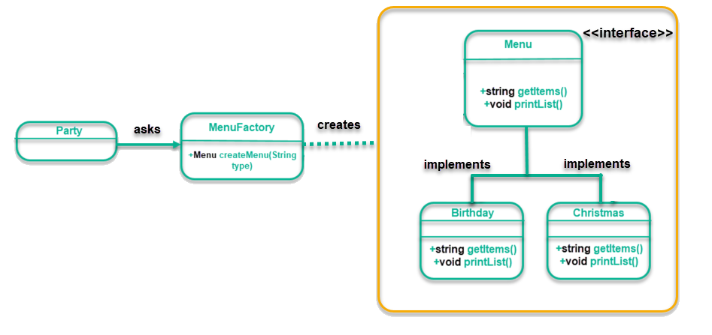
Factory Pattern UML

Slide 19
Expanding Factory Method Example

Slide 20
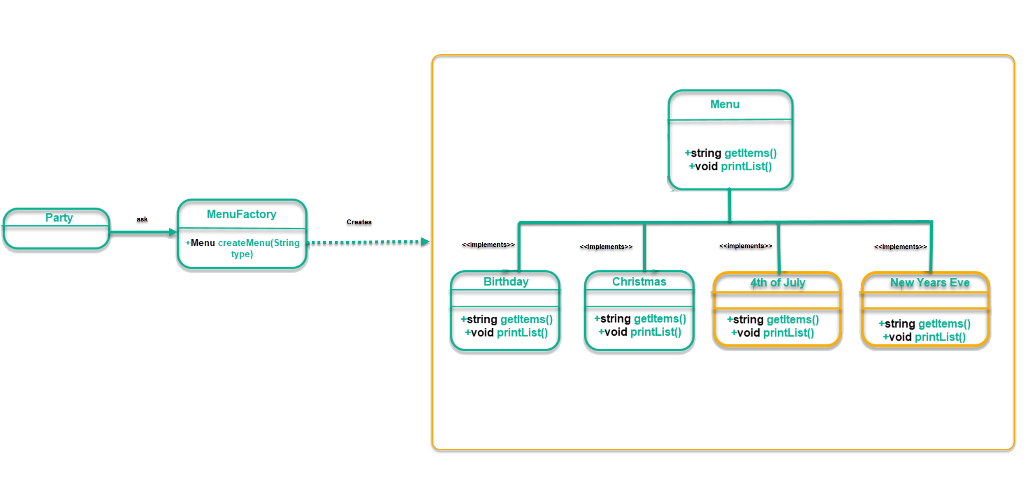
Factory Pattern UML

Slide 21
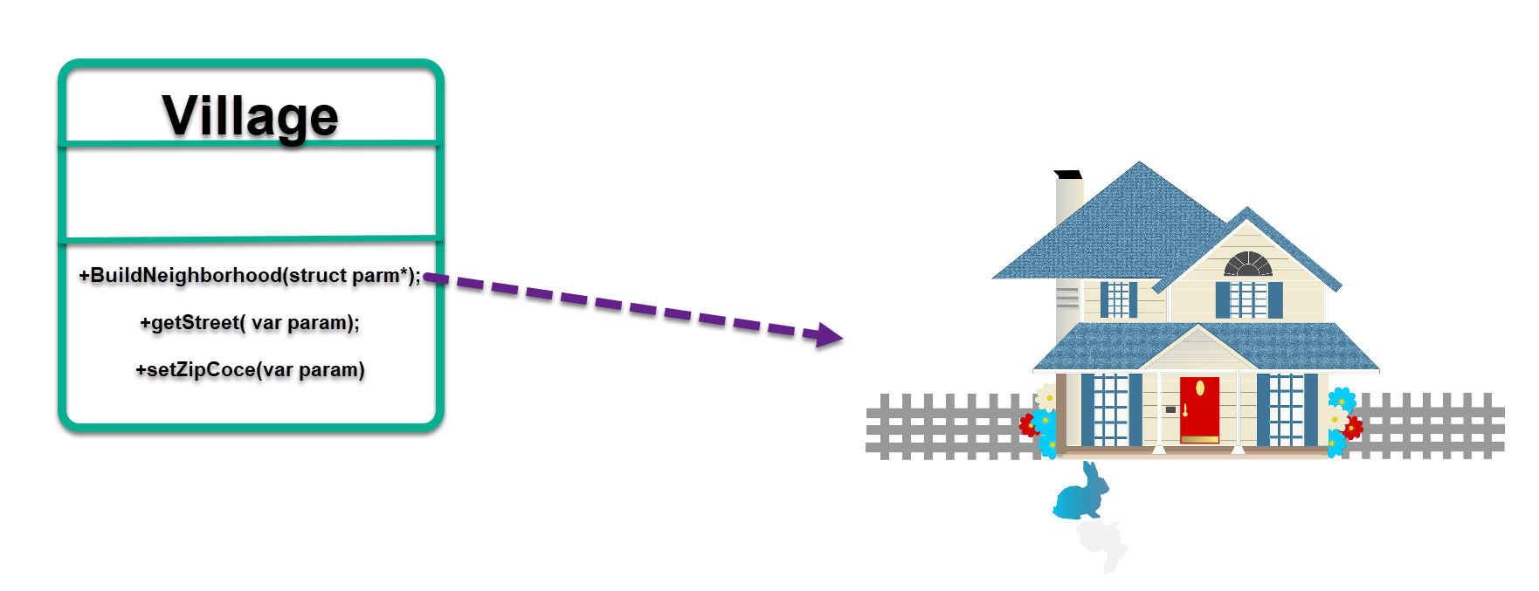
Example of Dependencies
Notes:
Let’s say, you have a class village, that needs some house objects for its method “BuildNeighborhood()”. However you do not want to overload the logic of the class “Village” constructing the house, and worrying it with its dependencies

Slide 22
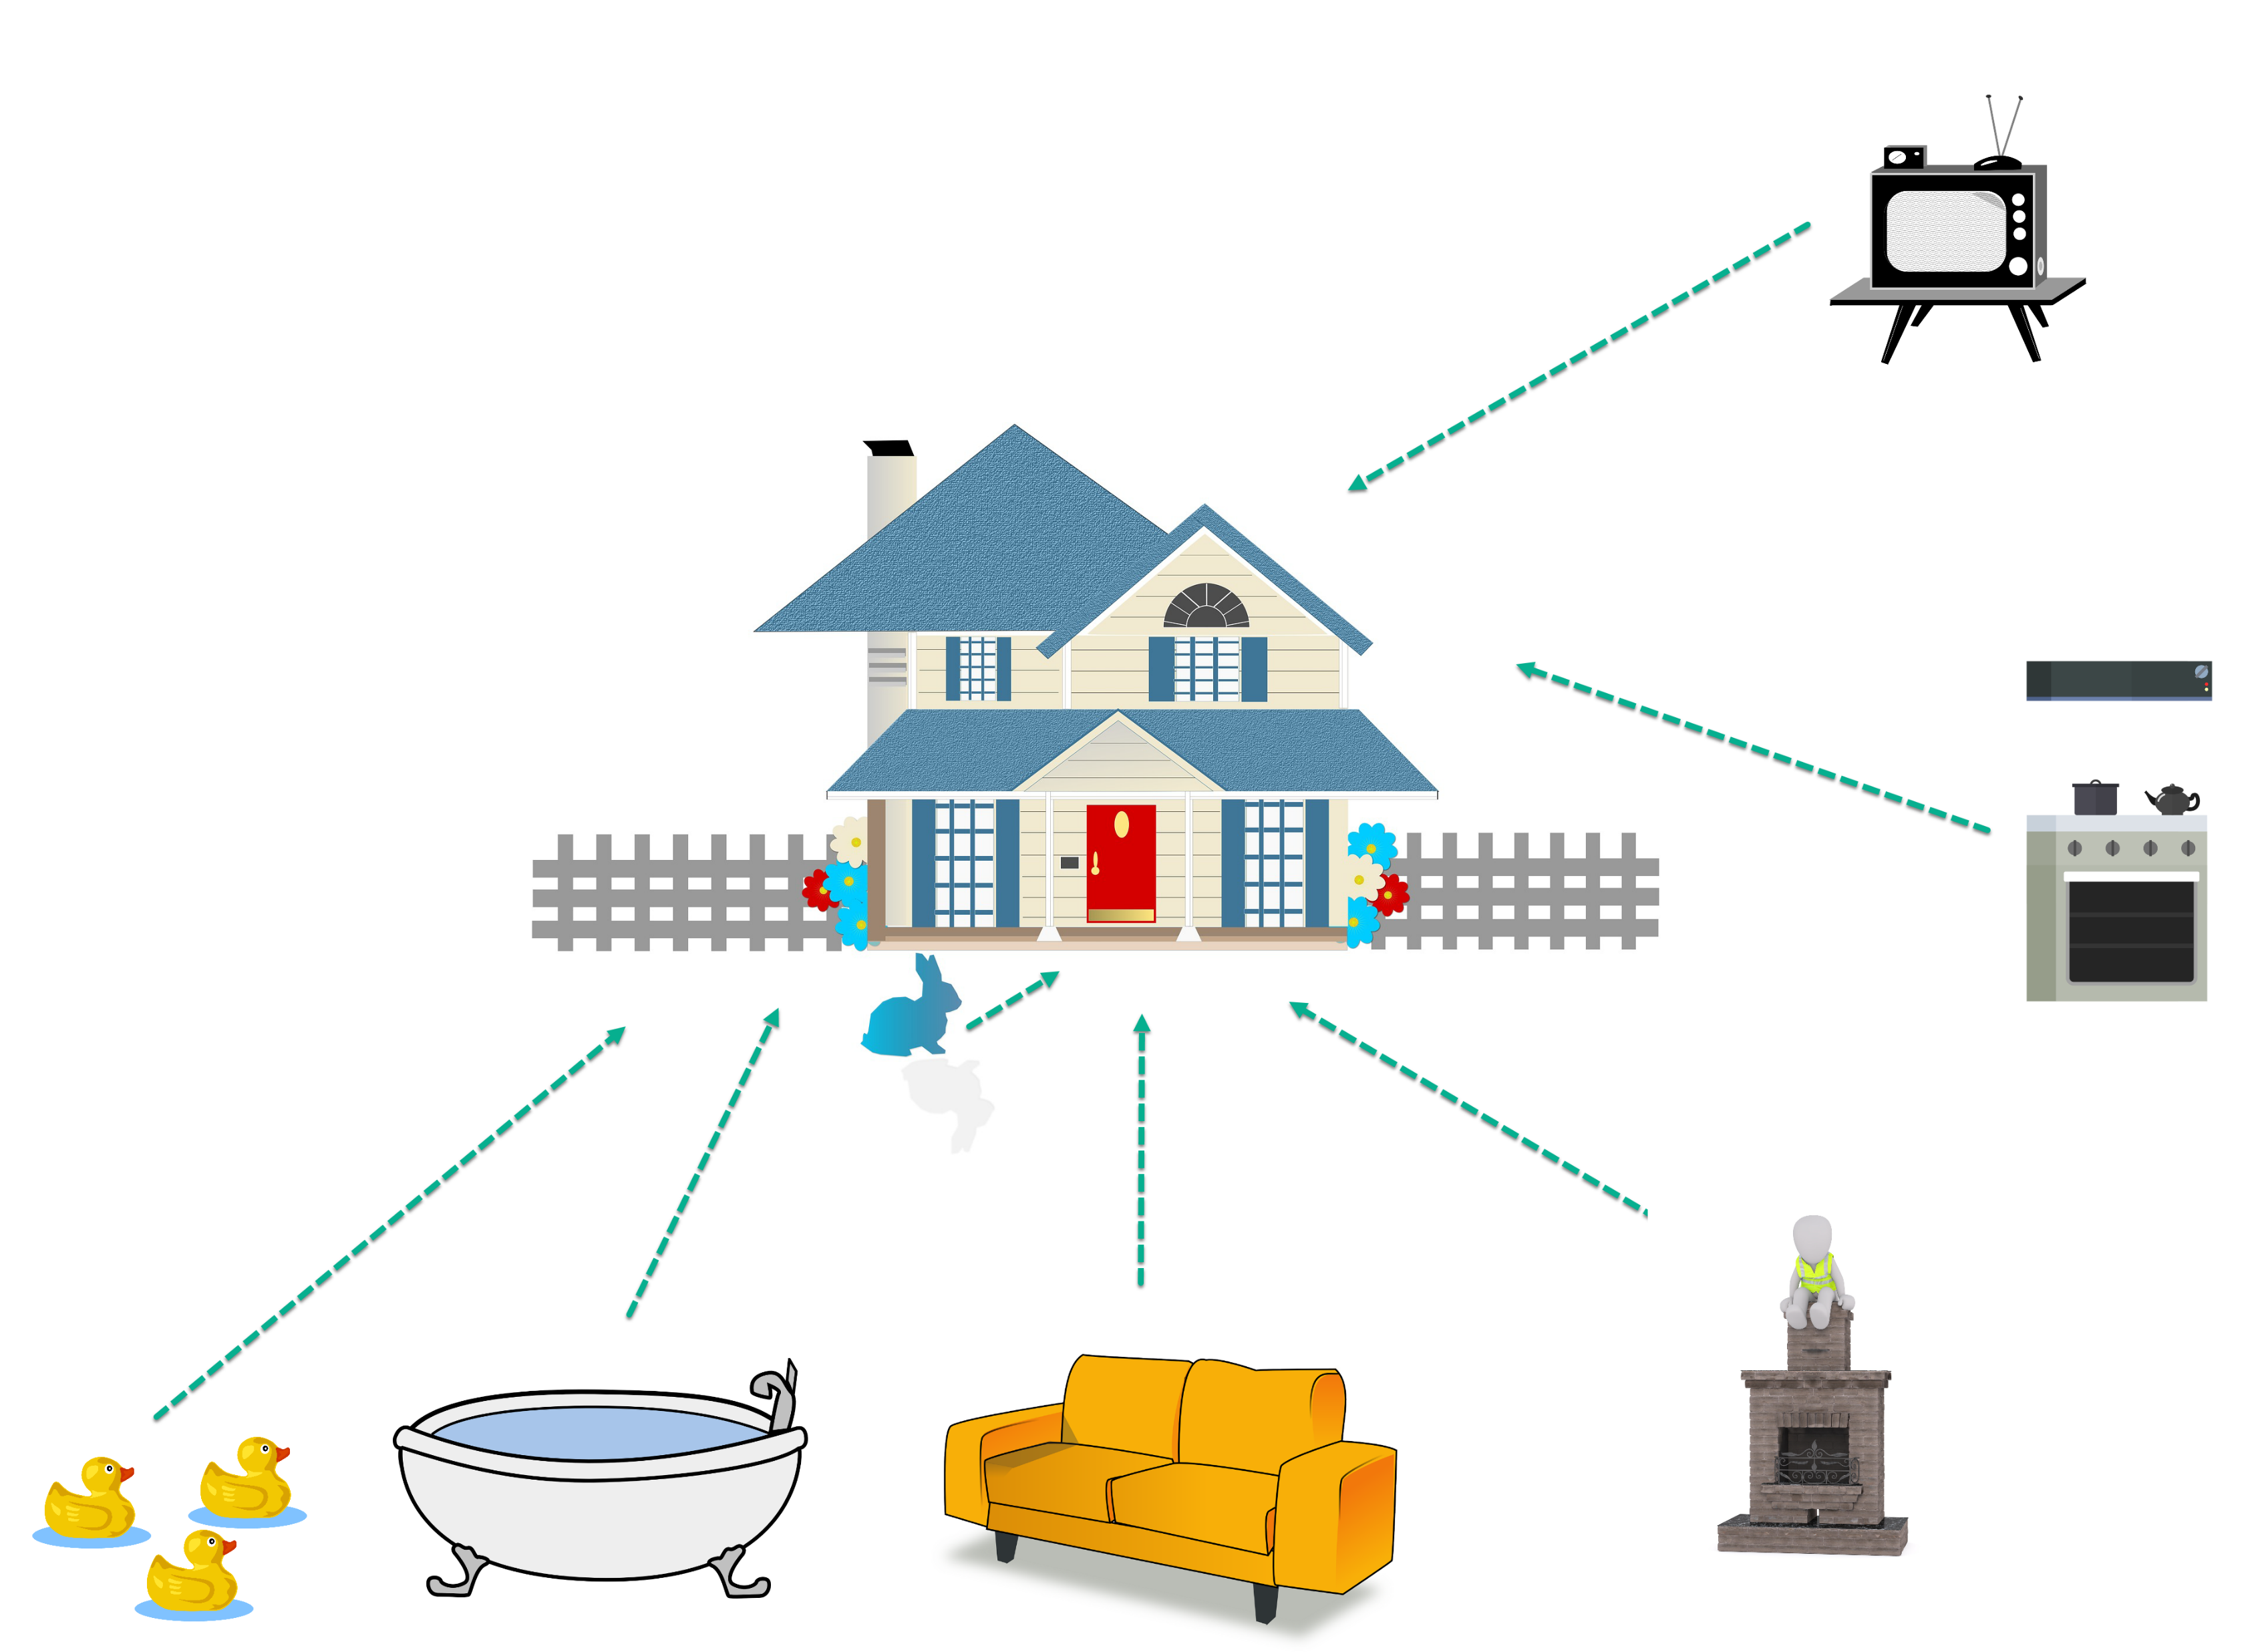
Notes:
.- Since to build a house depends on the TV object, Oven, Fire Place, Couch, Bath tube, some rubber ducks, and this cute little bunny in the front yard

Slide 23
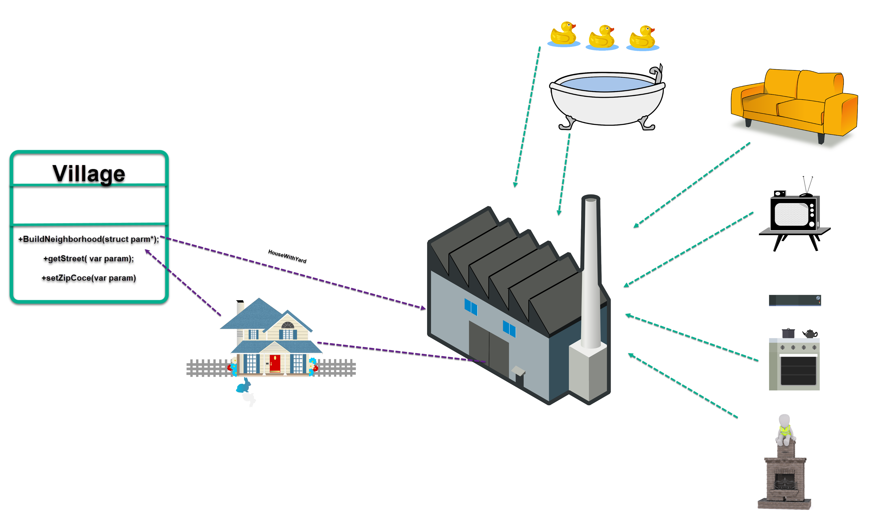
Factory Method Pattern
Notes:
-So the factory takes care of the construction of the house, and all its dependencies and logic how to create the object house.

Slide 24
Benefits
Obtain objects without knowing its constructors
No need to know all the dependencies
Extensibility
Notes:
- Factory allows to create objects without knowing the details how an object is created , and what are its dependencies. You just Ask the Factory an object and it is returned to you.
- Factory are useful when you need a complicated process for constructing the object , when the construction need a dependency that you do not want for the actual class.

Slide 25
When to use it?
Want a method to return one of the several objects that share the same super class
Decouple the logic of creating an object from the class that is consuming it

Slide 26


Slide 27
Abstract Factory Pattern
“Provides an interface for creating families of related or dependent objects without specifying their concrete classes”

Slide 28
Benefits
Interfaces – Good for Unit Testing
Have objects interact through common interfaces
Challenges
Can get complicated
Notes:
Good for unit test, since you want to test the “public” methods, and not the private ones – The implementation

Slide 29
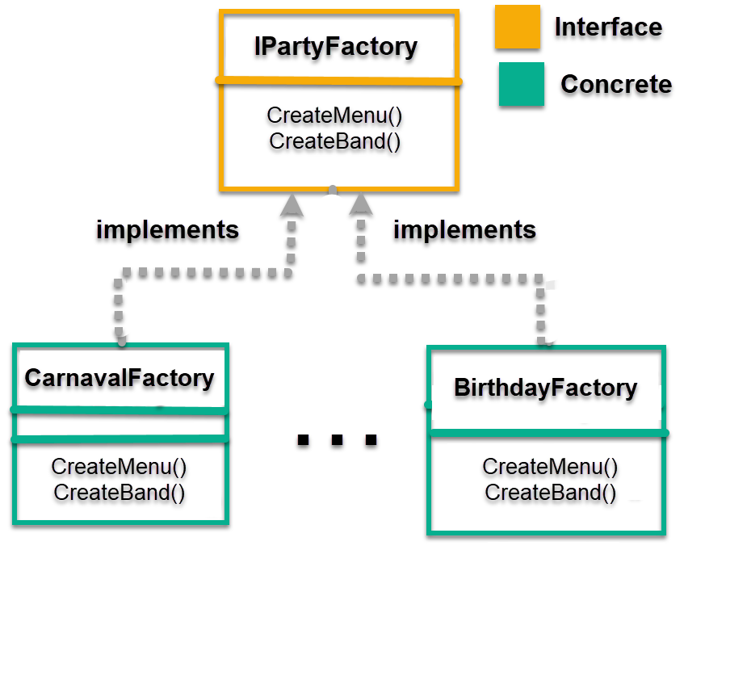
Abstract Factory

Slide 30
Code Example

Slide 31
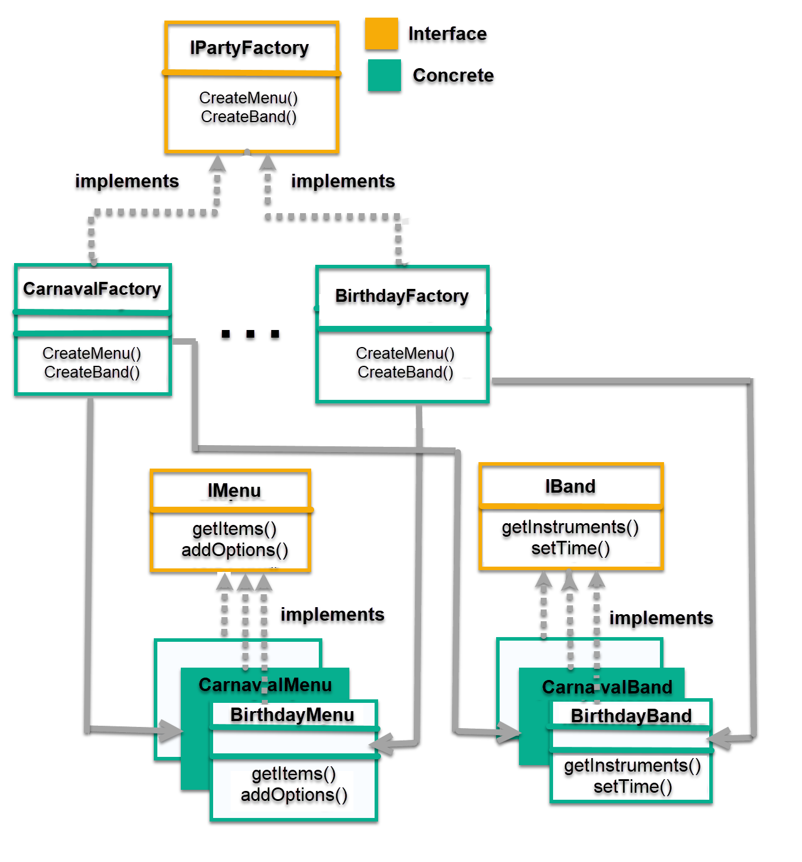
Abstract Factory

Slide 32
Questions?

Slide 33


